Slide 1
Unit 5 Non Parametric Methods

Slide 2
Example: Exam Prep

Slide 3
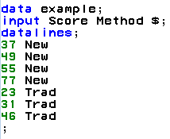
Exam Preparation
IBM gives each employee in the marketing department technical training
Based on further testing, it appears the traditional training method isn’t effective
Hence, a new training method is developed
Below are the test scores of 4 individuals who just finished the “New Method” and the last 3 test scores from employees trained via the “Traditional Method” course
Is there evidence to suggest that the “New Method” increases test scores?
New Method | Traditional Method
37 | 23
49 | 31
55 | 46
77

Slide 4
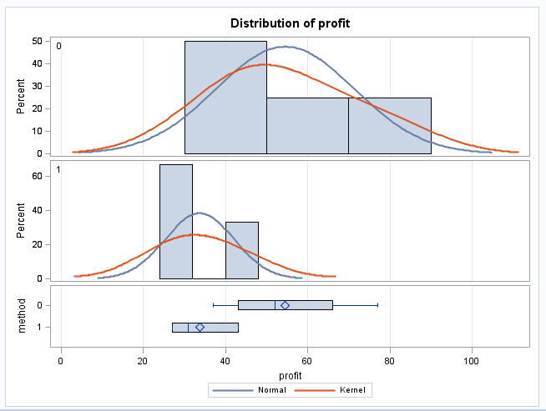
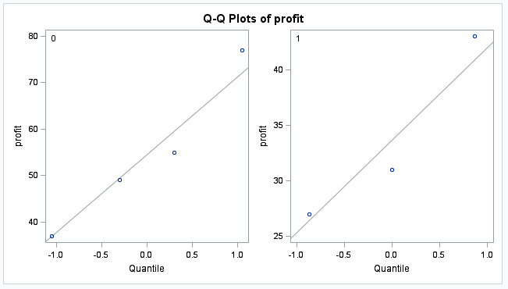
Examining the t-Tools Assumptions
2
2
1
1
Begin in R:
Score<- c(37, 49, 55, 77, 23, 31, 46)
Score
Method <- c("New", "New", "New", "New", "Trad", "Trad", "Trad")
Method
#To combine into one data set if needed
Example_df<-data.frame(Score, Method)
Example_df
Since the standard deviations appear (visual check) to be different and the sample sizes are both different and exceptionally small, the t-test was not deemed appropriate and the nonparametric rank sum test was performed.

Slide 5
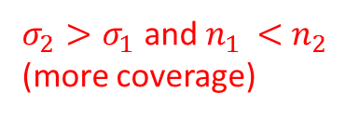
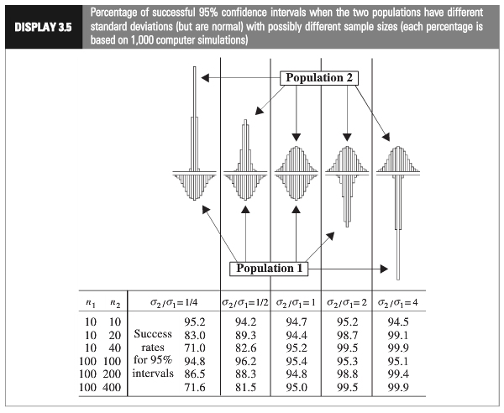
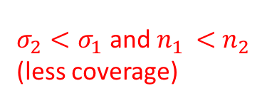
2
1
Which situation does it appear we are in?
$σ_{2}<σ_{1}$ and $n_{1 }<$ $n_{2 }$
(less coverage)
$σ_{2}>σ_{1}$ and $n_{1 }<$ $n_{2 }$
(more coverage)
Using a t-test could have low power.
Notes:
Worst case: the variance from the larger group is smaller than the variance from smaller group:

Slide 7
Comparison with T-Test

Slide 8
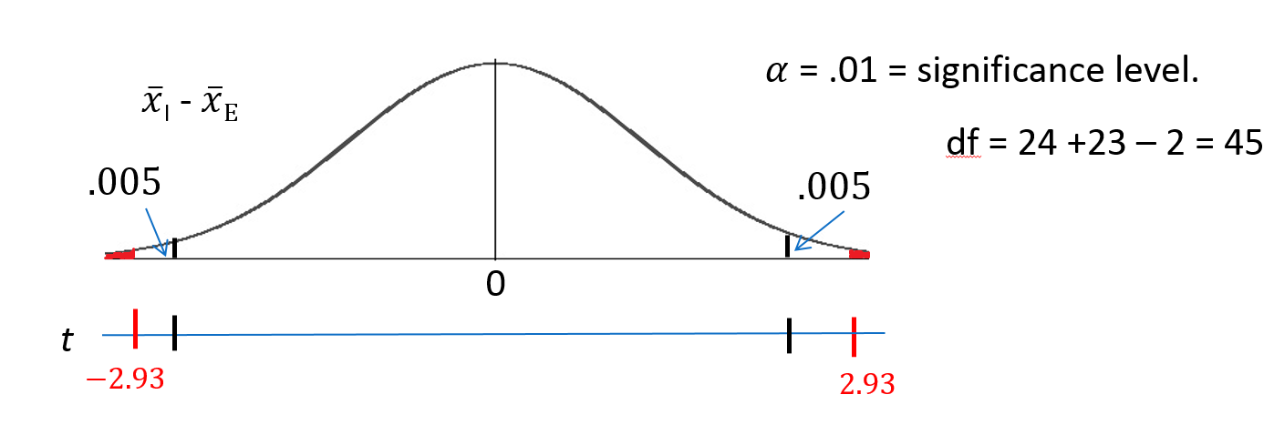
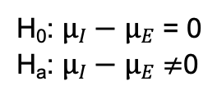
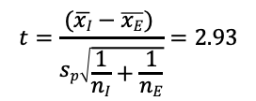
Let’s Formalize This Test Into 6 Steps!
We would like to test the claim that the mean score of the Intrinsic group is different than that of the Extrinsic group$.$ To do this, we take a sample of size n_{I} = 24 and n_{E} = 23 and find that $\overline{x}$_{I} = 19.88, points $\overline{x}E$ = 15.74, s_{I} = 4.44, and s_{E}= 5.25 points.
Step 1: Identify the null (H₀) and alternative (H_{a}) hypothesis.
H₀: $µI−µE$ = 0
H_{a}: $µI−µE$ $≠$0
Step 2: Draw and Shade and Find the Critical Value.
Step 3: Find the test statistic. (The t value for the data.)
$$t=\frac{(\overline{xI}−\overline{xE}) }{sp\sqrt{\frac{1}{nI}+\frac{1}{nE}}}=2.93$$
Step 4: Find the p-value: P-value: P($\left|{\overline{x}}_{I}−{\overline{x}}_{E}\right|>2.93 | µI−µE\text{ = 0})$ = 0.0054 < 0.01
Step 5: REJECT H₀.
Step 6: There is sufficient evidence to suggest that those who receive the Intrinsic treatment have a different mean score than those who receive the Extrinsic treatment (p-value = 0.0054 from a t-test). We can also claim that the mean intrinsic score is greater than the extrinsic one since the difference in sample means favors the Intrinsic group. (The burden of rejecting the null hypothesis for a one-tailed test is less than a two-tailed test, given the test is in the relevant direction.)

Slide 9
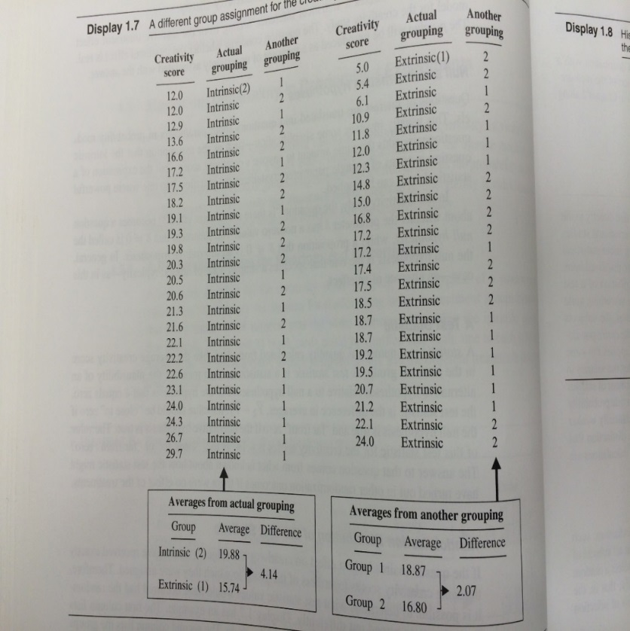
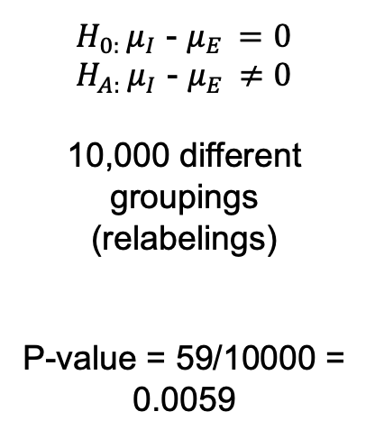
Motivation and Creativity : Conclusion
$H_{0: }μ_{I}$ - $μ_{E }=0$
$H_{A: }μ_{I}$ - $μ_{E }≠0$
10,000 different groupings (relabelings)
P-value = 59/10000 = 0.0059
-4.14
4.14
Conclusion (Client Facing): There is strong evidence to suggest that the mean score of those that would take the ”Intrinsic" method is different from the mean score of those that would take the ”Extrinsic" treatment (pvalue = .0059 from a permutation test).

Slide 10
Compare with non normal sampling distribution … t-test robust … same as permutation test.
creativity <- read.table(file.choose(),header = T,sep = ",");
creativity[3:23,1] = creativity[3:23,1]^1.5
creativity[41:47,1] = creativity[41:47,1]^1.8
xbars = creativity %>% group_by(Treatment_S) %>% summarize(mean = mean(Score))
xbarNminusT = xbars[2,2] - xbars[1,2] # observed difference xbarIntrinsic - xbarExtrinsic = 21.16667
xbarNminusT
set.seed(2) # So we all get the same randomizations and thus the same values ... comment this out to see how the result changes based on the randomization.
xbarDiffHolder = numeric(10000)
for (i in 1:10000)
{
scrambledLabels = sample(creativity$Treatment_S,47); #shuffle the Labels
creativityTemp = creativity
creativityTemp$Treatment_S = scrambledLabels
xbars = creativityTemp %>% group_by(Treatment_S) %>% summarize(mean = mean(Score))
xbarNminusT = xbars[2,2] - xbars[1,2] # observed difference xbarIntrinsic - xbarExtrinsic = 21.16667
xbarNminusT
xbarDiffHolder[i] = xbarNminusT$mean
}
ggplot(mapping = aes(x = xbarDiffHolder), color = "black") + geom_histogram(bins = 25, color = "black", fill = "blue")
num_more_extreme = sum((abs(xbarDiffHolder)) >= 4.14)
num_more_extreme
pvalue = num_more_extreme / 10000
pvalue

Slide 12
Inference for the Variance

Slide 14
Example: O-Ring Study

Slide 15
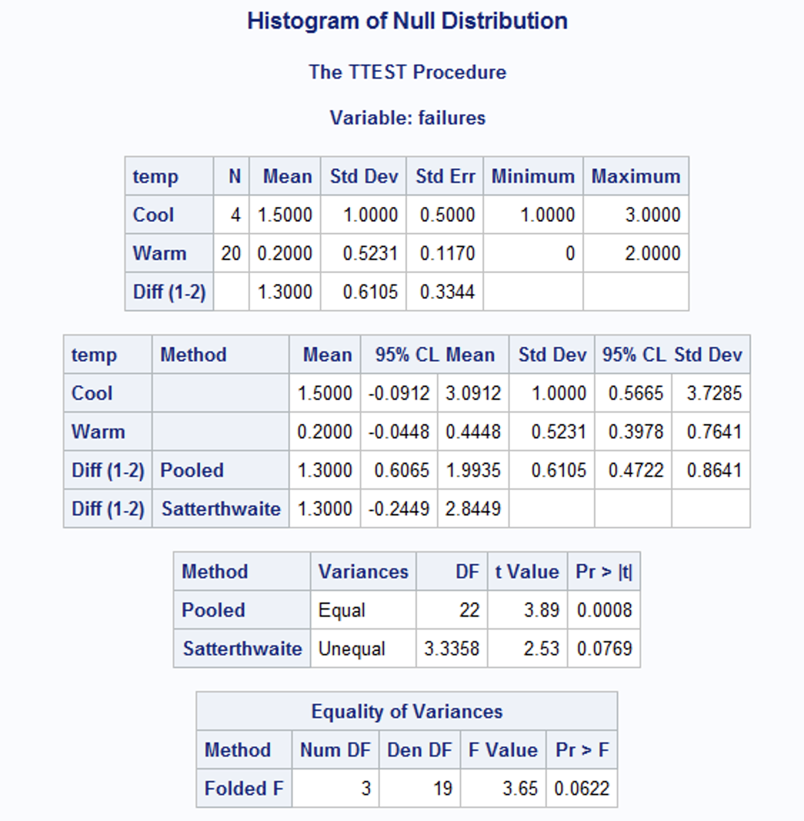
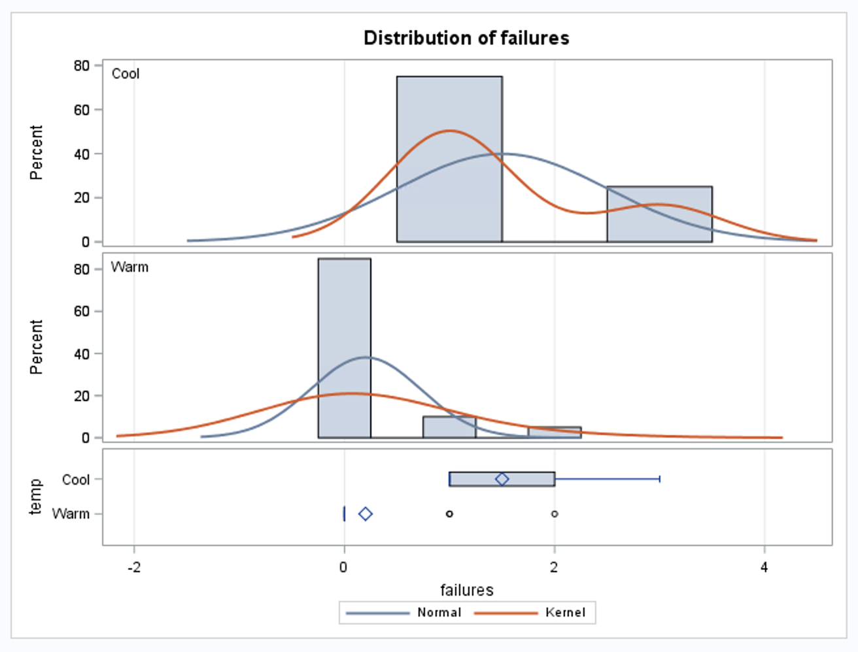
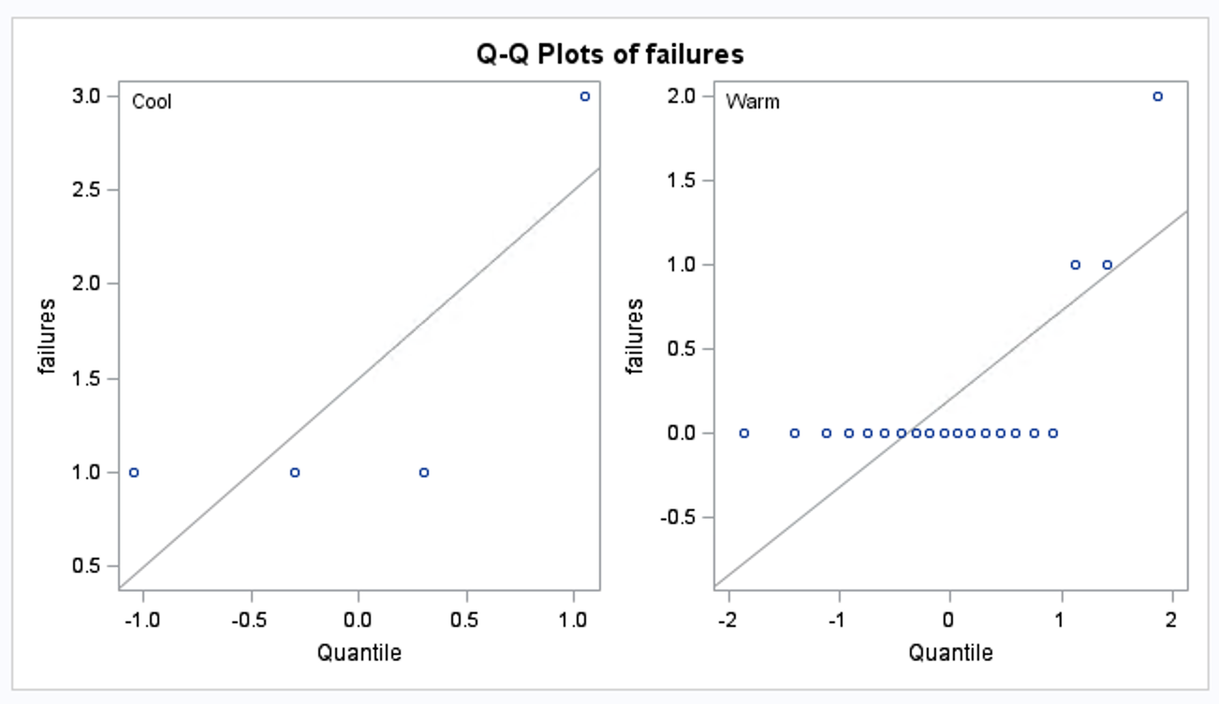
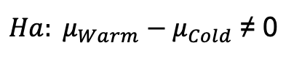
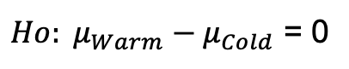
O-Ring Study: T-Test?
$Ho: μ_{Warm}−μ_{Cold}$ = 0
data Oring;
input failures temp $;
datalines;
1 Cool
1 Cool
1 Cool
3 Cool
0 Warm
0 Warm
0 Warm
0 Warm
0 Warm
0 Warm
0 Warm
0 Warm
0 Warm
0 Warm
0 Warm
0 Warm
0 Warm
0 Warm
0 Warm
0 Warm
0 Warm
1 Warm
1 Warm
2 Warm
;
proc ttest data = Oring;
class temp;
var failures;
run;
$Ha: μ_{Warm}−μ_{Cold}$ ≠ 0

Slide 16
O-Ring Study: SAS CODE
/*O-Ring Study */
proc iml;
Warm = {0,0,0,0,0,0,0,0,0,0,0,0,0,0,0,0,0,1,1,2};
Cold = {1,1,1,3};
obsdiff = mean(Warm) - mean(Cold);
print obsdiff;
call randseed(12345); /* set random number seed */
alldata = Warm // Cold; /* stack data in a single vector */
N1 = nrow(Warm); N = N1 + nrow(Cold);
NRepl = 9999; /* number of permutations */
nulldist = j(NRepl,1); /* allocate vector to hold results */
x = sample(alldata, N//NRepl, "WOR"); /* create all resamples */
nulldist = x[,1:N1][,:] - x[,(N1+1):N][,:]; /* compute all mean differences */
title "Histogram of Null Distribution";
refline = "refline " + char(obsdiff) + " / axis=x lineattrs=(color=red);";
call Histogram(nulldist) other=refline;
create newds from nulldist;
append from nulldist;
run;
data pvaluecalc;
set newds;
count = 0;
if (COL1 >= .1) then count = count + 1;
pvalue = count / 10000;
run;
proc univariate data = pvaluecalc;
var pvalue;
output out = pvalue sum = pvalue;
run;
proc print data = pvalue;
run;
https://blogs.sas.com/content/iml/2014/11/21/resampling-in-sas.html

Slide 17
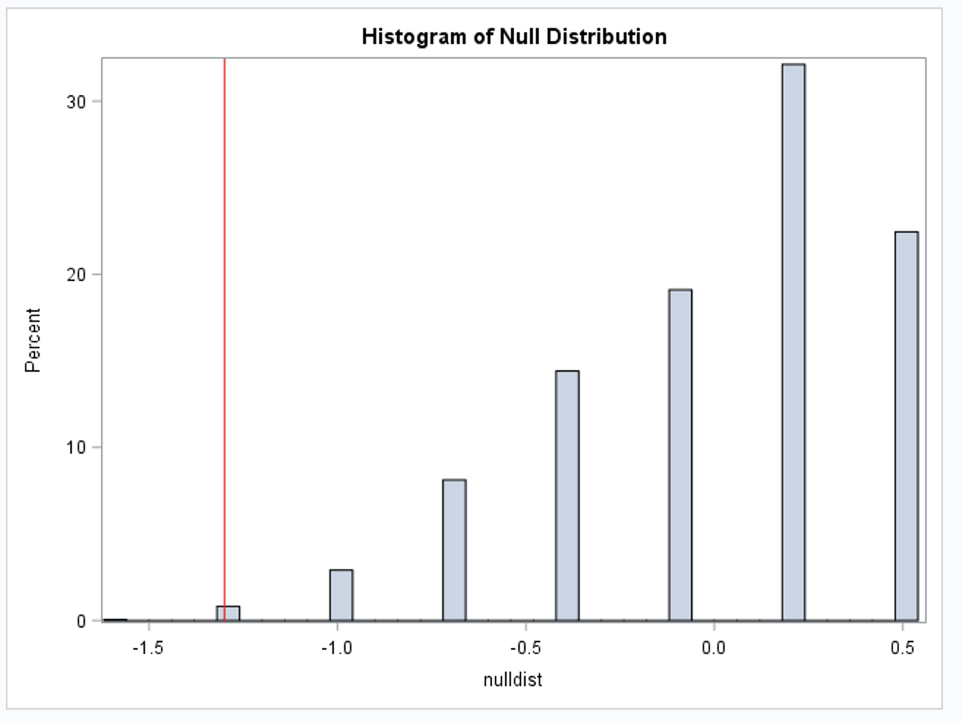
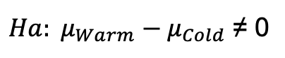
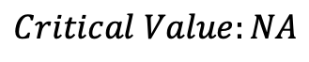
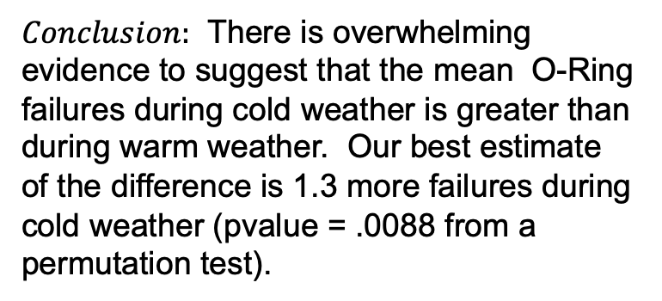
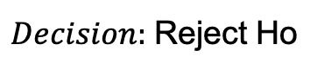
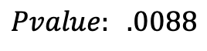
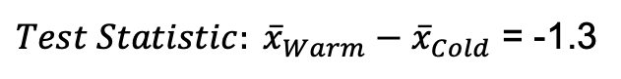
O-Ring Study
$Ho: μ_{Warm}−μ_{Cold}$ = 0
$Ha: μ_{Warm}−μ_{Cold}$ ≠ 0
$$Critical Value:NA$$
$Test Statistic: {\overline{x}}_{Warm}−{\overline{x}}_{Cold}$ = -1.3
$$Pvalue: .0088$$
$Decision:$Reject Ho
$Conclusion:$ There is overwhelming evidence to suggest that the mean O-Ring failures during cold weather is greater than during warm weather. Our best estimate of the difference is 1.3 more failures during cold weather (pvalue = .0088 from a permutation test).

Slide 18
O-Ring Study: R CODE
# Oring R Code Permuation Test Example
Oring <- read.csv(file.choose(),header = TRUE); # This reads it in if you directory is set to the right folder.
t.test(Oring$Failures ~ Oring$Temp)
number_of_permutations = 10000;
xbarholder = c();
counter = 0;
observed_diff = mean(subset(Oring, Temp == "Warm")$Failures)-mean(subset(Oring, Temp == "Cool")$Failures)
for(i in 1:number_of_permutations)
{
scramble = sample(Oring$Failures,24);
Warm = scramble[1:20];
Cool = scramble[21:24];
diff = mean(Warm)-mean(Cool);
xbarholder[i] = diff;
if(diff <= observed_diff)
counter = counter + 1;
}
hist(xbarholder, col = "lightblue", main = "Differences Means Under Ho", xlab = "Diff of Means");
abline(v = observed_diff,col = "red", lwd = 3);
pvalue = counter / number_of_permutations;
pvalue

Slide 19
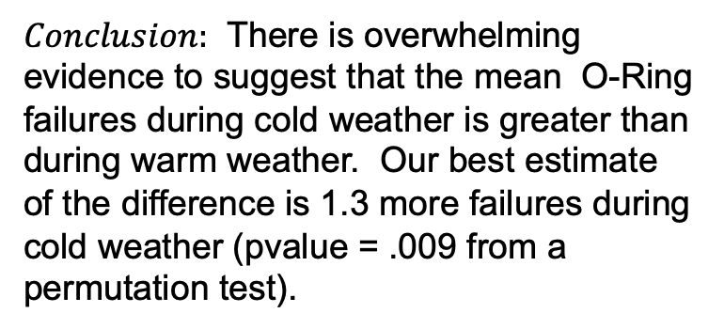
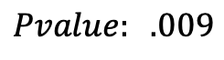
O-Ring Study
$Ho: μ_{Warm}−μ_{Cold}$ = 0
$Ha: μ_{Warm}−μ_{Cold}$ ≠ 0
$$Critical Value:NA$$
$Test Statistic: {\overline{x}}_{Warm}−{\overline{x}}_{Cold}$ = -1.3
$$Pvalue: .009$$
$Decision:$Reject Ho
$Conclusion:$ There is overwhelming evidence to suggest that the mean O-Ring failures during cold weather is greater than during warm weather. Our best estimate of the difference is 1.3 more failures during cold weather (pvalue = .009 from a permutation test).

Slide 21
The “Exact” Test

Slide 22
Exam Preparation
IBM gives each employee in the marketing department technical training
Based on further testing, it appears the traditional training method isn’t effective
Hence, a new training method is developed
Below are the test scores of 4 individuals who just finished the “New Method” and the last 3 test scores from employees trained via the “Traditional Method” course
Is there evidence to suggest that the “New Method” increases test scores?
New Method | Traditional Method
37 | 23
49 | 31
55 | 46
77

Slide 23
Examining the t-Tools Assumptions
2
2
1
1
Begin in R:
Score<- c(37, 49, 55, 77, 23, 31, 46)
Score
Method <- c("New", "New", "New", "New", "Trad", "Trad", "Trad")
Method
#To combine into one data set if needed
Example_df<-data.frame(Score, Method)
Example_df
Since the standard deviations appear (visual check) to be different and the sample sizes are both different and exceptionally small, the t-test was not deemed appropriate and the nonparametric rank sum test was performed.

Slide 24
2
1
Which situation does it appear we are in?
$σ_{2}<σ_{1}$ and $n_{1 }<$ $n_{2 }$
(less coverage)
$σ_{2}>σ_{1}$ and $n_{1 }<$ $n_{2 }$
(more coverage)
Using a t-test could have low power.
Notes:
Worst case: the variance from the larger group is smaller than the variance from smaller group:

Slide 25
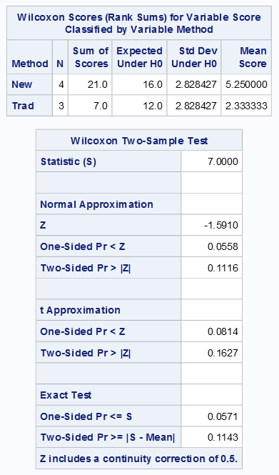
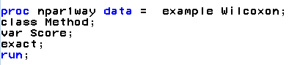
Permutation Test (Exact P-value)
Normal approximation p-values
Exact p-values
In R:
wilcox.test(Score~Method, alternative = "two.sided")
#OR
wilcox.test(Score~Method, exact = TRUE, alternative = "two.sided")

Slide 26
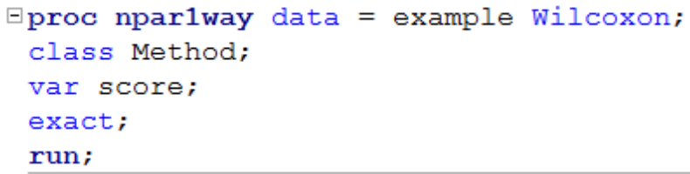
Rank Sum Test (Wilcoxon)
H₀: The distribution of New Method Scores = The distribution of the Traditional Method Scores
H₁:The distribution of New Method Scores > The distribution of the Traditional Method Scores
Critical Value: -1.645
There is sufficient evidence at the alpha = 0.1 level of significance (p-value = .0571 for the exact test) to suggest that the distribution of scores from four IBM employees that were given the New Method is greater than the distribution of the 3 employees that took the test having had the Traditional Method of instruction.

Slide 28
The Normal Approximation

Slide 29
Nonparametric Methods: The Rank Sum Test

Slide 30
Nonparametric Methods
A nonparametric or distribution-free test doesn’t depend on underlying assumptions
This makes them ideal for use when the assumptions of non-nonparametric (that is, parametric) tests aren’t met
The trade-off is that nonparametric methods perform somewhat worse than parametric methods if the assumptions are approximately correct
The first nonparametric method we will consider is the ”rank sum test”

Slide 31
Rank Sum Test: Advantages
No distributional assumptions
Resistant to outliers
Performs nearly as well as the t-test when the two populations are normal and considerably better when there are extreme outliers
Works well with ordinal (as opposed to interval data)
Works with censored values
It still requires some assumptions:
All observations are independent
The Y values are ordinal
59 patients with arthritis who participated in a clinical trial were assigned to two groups, active and placebo. The response status:
(excellent=5, good=4, moderate=3, fair=2, poor=1)
of each patient was recorded.

Slide 32
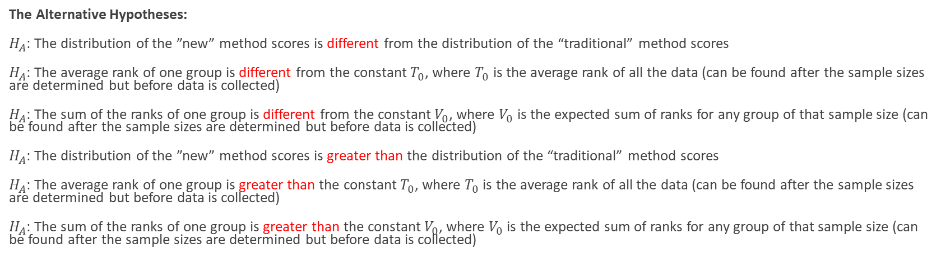
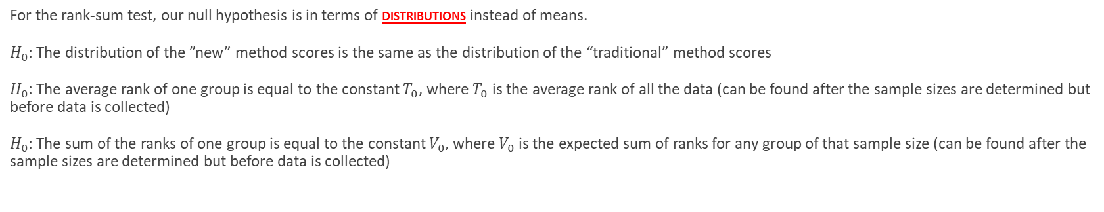
The Hypothesis Test
For the rank-sum test, our null hypothesis is in terms of distributions instead of means.
$H_{0}$: The distribution of the ”new” method scores is the same as the distribution of the “traditional” method scores
$H_{0}$: The average rank of one group is equal to the constant $T_{0}$, where $T_{0}$ is the average rank of all the data (can be found after the sample sizes are determined but before data is collected)
$H_{0}$: The sum of the ranks of one group is equal to the constant $V_{0}$, where $V_{0}$ is the expected sum of ranks for any group of that sample size (can be found after the sample sizes are determined but before data is collected)
The Alternative Hypotheses:
$H_{A}$: The distribution of the ”new” method scores is different from the distribution of the “traditional” method scores
$H_{A}$: The average rank of one group is different from the constant $T_{0}$, where $T_{0}$ is the average rank of all the data (can be found after the sample sizes are determined but before data is collected)
$H_{A}$: The sum of the ranks of one group is different from the constant $V_{0}$, where $V_{0}$ is the expected sum of ranks for any group of that sample size (can be found after the sample sizes are determined but before data is collected)
$H_{A}$: The distribution of the ”new” method scores is greater than the distribution of the “traditional” method scores
$H_{A}$: The average rank of one group is greater than the constant $T_{0}$, where $T_{0}$ is the average rank of all the data (can be found after the sample sizes are determined but before data is collected)
$H_{A}$: The sum of the ranks of one group is greater than the constant $V_{0}$, where $V_{0}$ is the expected sum of ranks for any group of that sample size (can be found after the sample sizes are determined but before data is collected)
(Two sided)
(one sided)

Slide 33
The Rank Sum test
We can compute the rank sum test statistic using the following steps:
List all observations from both groups in increasing order
Assign each observation a rank, from 1 to n
If there are any ties, assign each tied observation’s rank to be the average of their ranks.
Identify each observation by its group
The test statistic, T, is the sum of the ranks in one of the groups.
We can find a p-value in two ways:
Normal approximation
Re-randomization (exact or approximate)
Note: n is the total # of observations

Slide 34
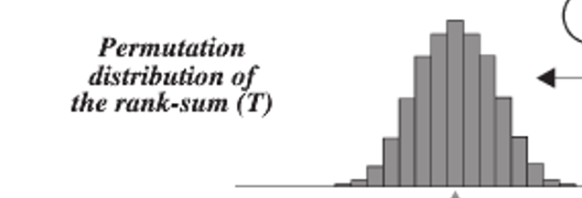
The Sampling Distribution of …
The Rank Sum Statistic!
Rank Sum test statistic (sum of ranks of one group) is approximately normally distributed!

Slide 35
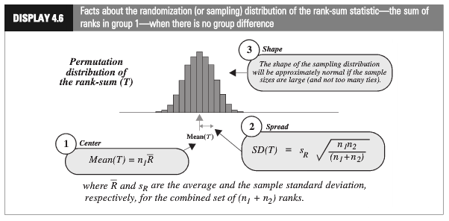
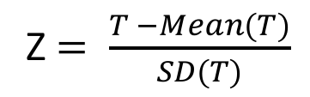
Rank-Sum Test: Normal Approximation
Z $= \frac{T −Mean(T)}{SD(T)}$

Slide 36
Rank Sum Test: randomly assign ranks (or positions)
Name | Order # | Group | Rank
Bob | 1 | New | 5
Sue | 2 | New | 7
Fred | 3 | New | 2
Jim | 4 | New | 1
Pam | 5 | Trad | 3
Tim | 6 | Trad | 4
Zac | 7 | Trad | 6
Name | Order # | Group | Rank
Sue | 1 | New | 7
Bob | 2 | New | 5
Fred | 3 | New | 2
Jim | 4 | New | 1
Pam | 5 | Trad | 3
Tim | 6 | Trad | 4
Zac | 7 | Trad | 6
Name | Order # | Group | Rank
Pam | 1 | New | 3
Tim | 2 | New | 4
Sue | 3 | New | 7
Zac | 4 | New | 6
Fred | 5 | Trad | 2
Bob | 6 | Trad | 5
Jim | 7 | Trad | 1
Record sum of ranks of one group for all 7! permutations of ranks. (7!=7*6*5*4*3*2*1)
P-value is the number of permutations with a sum equal to or more extreme than the one in the original data set divided by the total number of permutations.
*Could also do an approximate p-value by randomly choosing, say, 1000 orderings of the data.

Slide 37
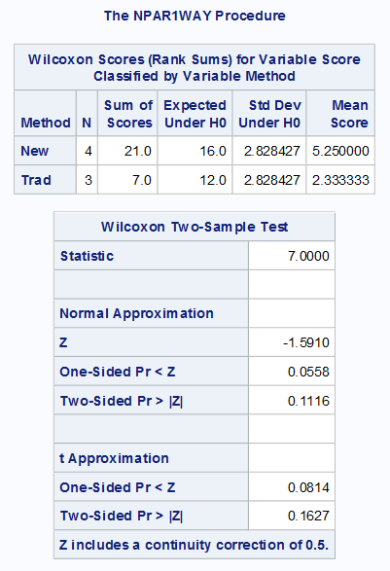
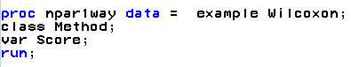
Rank-Sum Test: Normal Approximation
Common interpretation:
H₀: The distribution of New Method Scores = The distribution of the Traditional Method Scores
H₁:The distribution of New Method Scores > The distribution of the Traditional Method Scores
Technical mathematical interpretation:
H₀: Average rank of New Method Scores = Average rank of all Scores (constant)
H₁: Average rank of New Method Scores > Average rank of all Scores (constant)
There is mild evidence (alpha = 0.1) to suggest that the distribution of scores from the “New” method is greater than the distribution of the “Traditional” method (normal approximation to rank-sum test p-value = 0.0558).

Slide 39
Continuity Correction

Slide 40
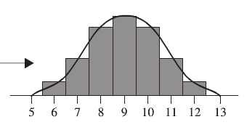
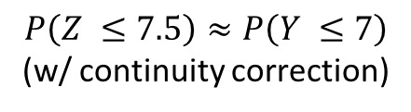
Continuity Correction: Main Idea
$P\left(Z ≤7\right)$ for a continuous Z is much smaller than $P\left(Y ≤7\right)$ for integer Y, (no continuity correction)
$$P\left(Z ≤7.5\right)≈P\left(Y ≤7\right)$$
(w/ continuity correction)
The exact probability calculation for $P(Y ≤7)$ when Y is an integer.

Slide 41
Rank-Sum Test: Normal Approximation
Common interpretation:
H₀: The distribution of New Method Scores = The distribution of the Traditional Method Scores
H₁:The distribution of New Method Scores > The distribution of the Traditional Method Scores
There is mild evidence (alpha = 0.1) to suggest that the distribution of scores from the “New” method is greater than the distribution of the “Traditional” method (normal approximation to rank-sum test p-value = 0.0558).

Slide 43
Example: Exam Prep with R

Slide 44
Rank Sum Test: R CODE
library(dplyr)
scoreDF = data.frame(Score = c(37,49,55,77,23,31,46), Treatment = c("New","New","New","New","Traditional","Traditional","Traditional"))
scoreDF %>% group_by(Treatment) %>% summarise(
count = n(),
median = median(Score, na.rm = TRUE),
IQR = IQR(Score, na.rm = TRUE)
)
scoreNew = filter(scoreDF,Treatment == "New")
scoreTrad = filter(scoreDF,Treatment == "Traditional")
wilcox.test(Failures ~ Temp, data = Oring, exact = TRUE) # Note … ignores Exact in in formula mode
wilcox.test(Failures ~ Temp, data = Oring, exact = FALSE)
wilcox.test(scoreNew$Score,scoreTrad$Score, exact = TRUE)
wilcox.test(scoreNew$Score,scoreTrad$Score, exact = TRUE, alternative = "g")
wilcox.test(scoreNew$Score,scoreTrad$Score, exact = FALSE, alternative = "g")
wilcox.test(scoreNew$Score,scoreTrad$Score, exact = FALSE, alternative = "g")
To Compare with SAS
http://www.sthda.com/english/wiki/unpaired-two-samples-wilcoxon-test-in-r

Slide 46
Example: Cognitive Load Theory in Teaching

Slide 47
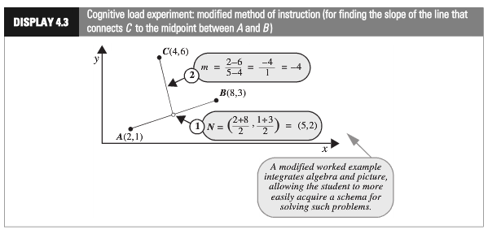
Cognitive Load Experiment
Researchers compared the effectiveness of conventional textbook examples to modified ones
They selected 28 ninth-year students, who had no previous exposure to coordinate geometry
The students were randomly assigned to one of two self study instructional groups, using conventional and modified instructional materials.
After instruction they were given a test and the time complete one of the problems was recorded.
Is there sufficient evidence to suggest that the cognitive load theory (modified instruction) shortened response times?

Slide 48
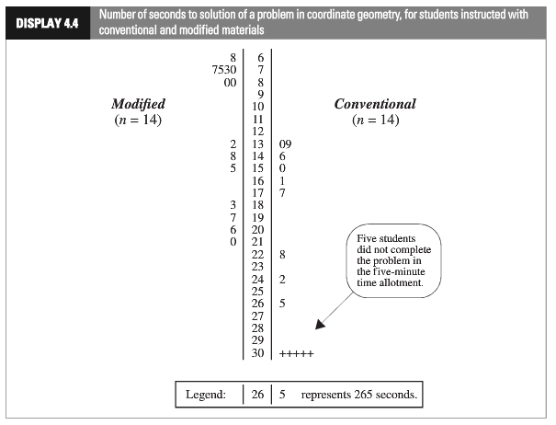
Cognitive Load Experiment
(censored data)

Slide 49
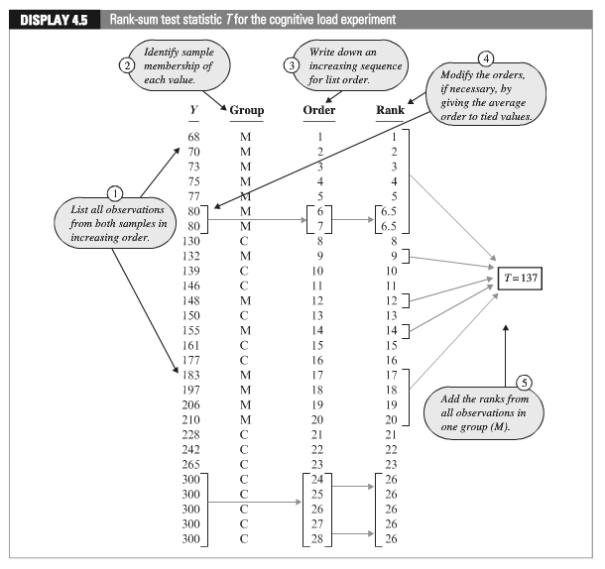
Cognitive Load Experiment

Slide 50
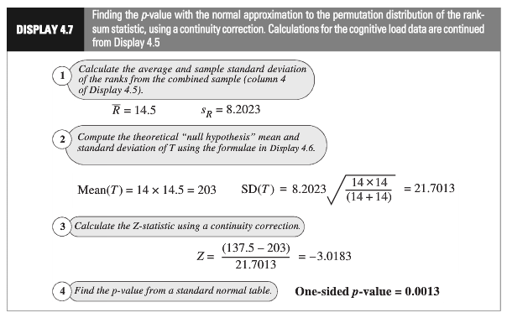
Cognitive Load Experiment: Normal Approximation
(continuity correction)
Statistical Conclusion: The data provide convincing evidence that a student could solve the problem more quickly after the “modiﬁed” rather than the the “conventional” method (one-sided, normal approximation w/ C.C. p-value = 0.0013, from the rank-sum test).

Slide 51
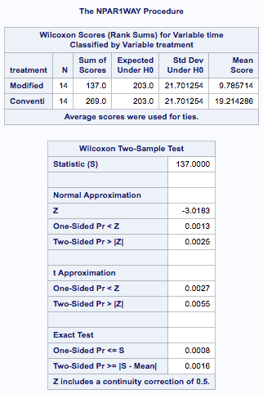
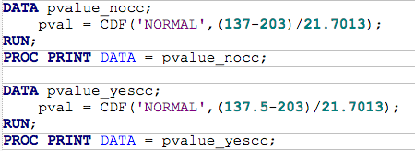
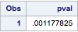
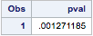
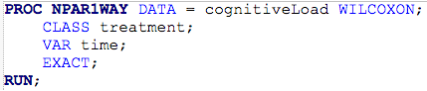
Cognitive Load Experiment: Using SAS

Slide 52
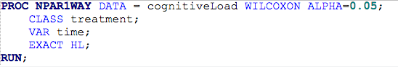
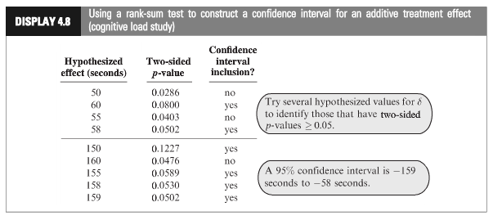
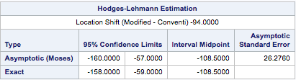
Cognitive Load Experiment
Statistical Conclusion (continued): A range of plausible values for how much smaller the “modified” distribution is than the “traditional” is [-158, -59] s. (95% conﬁdence interval based on a rank-sum test) with a point-estimate of 108.5 s.

Slide 53
Cognitive Load Experiment (All Together)
Ho: Distribution of Modified and Conventional Scores are equal.
Ha: Distribution of Modified Scores is less than that of Conventional
Critical Value (left sided): -1.645 (alpha = .05)
Test Statistic: tstat = -3.0183
Pvalue (left sided)= .0013
Reject Ho
Statistical Conclusion (continued): The data provide convincing evidence that a student could solve the problem more quickly after the “modiﬁed” rather than the the “conventional” method (one-sided, normal approximation w/ C.C. p-value = 0.0013, from the rank-sum test).A range of plausible values for how much smaller the “modified” distribution is than the “traditional” is [-158, -59] s. (95% conﬁdence interval based on a rank-sum test) with a point-estimate of 108.5 s.

Slide 55
Example: Sign and Sign Rank Test in SAS and R

Slide 56
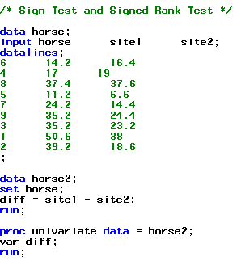
For each of the 9 horses, a veterinary anatomist measured the density of nerve cells at specified sites in the intestine.
Example: Nerve Data
horse | site1 | site2
6 | 14.2 | 16.4
4 | 17 | 19
8 | 37.4 | 37.6
5 | 11.2 | 6.6
7 | 24.2 | 14.4
9 | 35.2 | 24.4
3 | 35.2 | 23.2
1 | 50.6 | 38
2 | 39.2 | 18.6

Slide 57



Using the paired t-Test
The sample size is rather small, hence the normality assumption is suspect.

Slide 58

The Hypothesis Test
The hypotheses will be in terms of medians instead of means
$H_{0}$: The median difference in nerve cell count between “site 1” and “site 2” is zero
The Alternative Hypotheses:
$H_{A}$: The median difference in nerve cell count between “site 1” and “site 2” is not zero
$H_{A}$: The median difference in nerve cell count between “site 1” and “site 2” is greater than zero
(Two sided)
(one sided)

Slide 59



Sign Test: Horse Data
$H_{A}$: The median difference in nerve cell count between “site 1” and “site 2” is > 0
$$z= \frac{K−.5 −n/2}{\sqrt{n/4}}$$
horse | site1 | site2 | diff | Sign
8 | 37.4 | 37.6 | -0.2 | -
4 | 17 | 19 | -2 | -
6 | 14.2 | 16.4 | -2.2 | -
5 | 11.2 | 6.6 | 4.6 | +
7 | 24.2 | 14.4 | 9.8 | +
9 | 35.2 | 24.4 | 10.8 | +
3 | 35.2 | 23.2 | 12 | +
1 | 50.6 | 38 | 12.6 | +
2 | 39.2 | 18.6 | 20.6 | +
$$= \frac{6− .5 −9/2}{\sqrt{9/4}}=.6666$$
K = 6
$$P\left(Z>.6666\right)=0.2527$$
(one sided, CC p-value)

Slide 60
Test and Conclusion
$H_{0}$: The median difference in nerve cell count between “site 1” and “site 2” is zero
$H_{A}$: The median difference in nerve cell count between “site 1” and “site 2” is positive.
Critical Value (right sided): z_{0.05}=1.645
P-value (one sided) = .2527
t statistic: t_{stat} = 0.666
Fail to Reject H₀.
Statistical Conclusion: There is not enough evidence that the median nerve density at site 1 is greater than the median nerve density at site 2 (Wilcoxon sign test one-sided p-value of 0.2527).

Slide 61



Signed Rank Test: Horse Data
horse | site1 | site2 | abs(diff) | Sign | rank
8 | 37.4 | 37.6 | 0.2 | - | 1
4 | 17 | 19 | 2 | - | 2
6 | 14.2 | 16.4 | 2.2 | - | 3
5 | 11.2 | 6.6 | 4.6 | + | 4
7 | 24.2 | 14.4 | 9.8 | + | 5
9 | 35.2 | 24.4 | 10.8 | + | 6
3 | 35.2 | 23.2 | 12 | + | 7
1 | 50.6 | 38 | 12.6 | + | 8
2 | 39.2 | 18.6 | 20.6 | + | 9
$$z= \frac{S −Mean(S)}{SD(S)}$$
$$= \frac{39 − .5 −(9∗10)/4}{\sqrt{9∗10∗19/24}}=\text{1.}\text{89}$$
$$P\left(Z>1.89\right)=0.02938$$
S = 39
(one sided, CC p-value)

Slide 62
Test, Conclusion and Some Notes
$H_{0}$: The median difference in nerve cell count between “site 1” and “site 2” is zero
$H_{A}$: The median difference in nerve cell count between “site 1” and “site 2” is positive.
Critical Value (right sided): z_{0.05}=1.645
P-value (one sided) = .0294
t statistic: t_{stat} = 1.89
Reject H₀.
Statistical Conclusion: There is strong evidence that the median nerve density at site 1 is greater than the median nerve density at site 2 (Wilcoxon signed rank test one-sided p-value of 0.0294).
Note:
The signed-rank test has more power than the sign test
(Compare the p-values 0.254 vs. 0.0294)
Both tests make very few assumptions about the distributions

Slide 63

Horse Data
Note: These are two sided…. Half of this is close to our calculated one sided p-values from earlier.
Note: For n < 20 SAS uses the probabilities from the binomial distribution rather than the normal approximation. These are more accurate (exact) and we should use these when SAS is available.
R code: wilcox.test(horse$site1, horse$site2, paired = true)

Slide 65
Levene's (Median) Test of Equal Spread (Homogeneity)

Slide 66
Exam Preparation
IBM gives each employee in the marketing department technical training
Based on further testing, it appears the traditional training method isn’t effective
Hence, a new training method is developed
Below are the test scores of 4 individuals who just finished the “New Method” and the last 3 test scores from employees trained via the “Traditional Method” course
Is there evidence to suggest that the “New Method” increases test scores?
New Method | Traditional Method
37 | 23
49 | 31
55 | 46
77

Slide 67




Levene’s Test (Median)
H₀: σ₁= σ₂
H_{a}: σ₁≠ σ₂
But … proc ttest does not have Levene’s Test!!!

Slide 68


Brown Forsythe Test (Median)
H₀: Equal Spread
H_{a}: Different Spread
data exam;
input score type $;
datalines;
37 New
49 New
55 New
77 New
23 Traditional
31 Traditional
46 Traditional
;
proc glm data = exam;
class type;
model score = type;
means type / hovtest=bf;
run;
data mediandiff;
input diff type$;
datalines;
15 New
3 New
3 New
25 New
8 Traditional
0 Traditional
15 Traditional
;
proc ttest data = mediandiff;
class type;
var diff;
run;
There is not enough evidence to suggest the spread is different in the exam scores of those who took the new training versus the traditional training.

Slide 69



Levene’s Test (Mean)
H₀: Equal Spread
H_{a}: Different Spread
data exam;
input score type $;
datalines;
37 New
49 New
55 New
77 New
23 Traditional
31 Traditional
46 Traditional
;
proc glm data = exam;
class type;
model score = type;
means type / hovtest=levene(type = abs);
run;
data meandiff;
input diff type$;
datalines;
17.5 New
5.5 New
0.5 New
22.5 New
10.3333 Traditional
2.3333 Traditional
12.6666 Traditional
;
proc ttest data = meandiff;
class type;
var diff;
run;
There is not enough evidence to suggest the spread is different in the exam scores of those who took the new training versus the traditional training.

